Slide 1
Provisioning Build Tools
Feng Zhou & Haiming Ji
Jan 2021

Slide 2
Purpose
Automate the build activity
Improve the work efficiency
Reduce the type error and copy paste command
Reduce manual run script
Integration with single DUT testing in future

Slide 3
Features
Clone source from remote branch
Open local branch to auto launch VS2017
Build local branch and make local package
Upload/download local packages to NGET
Auto pull server build and generating package
Update External Drops

Slide 4
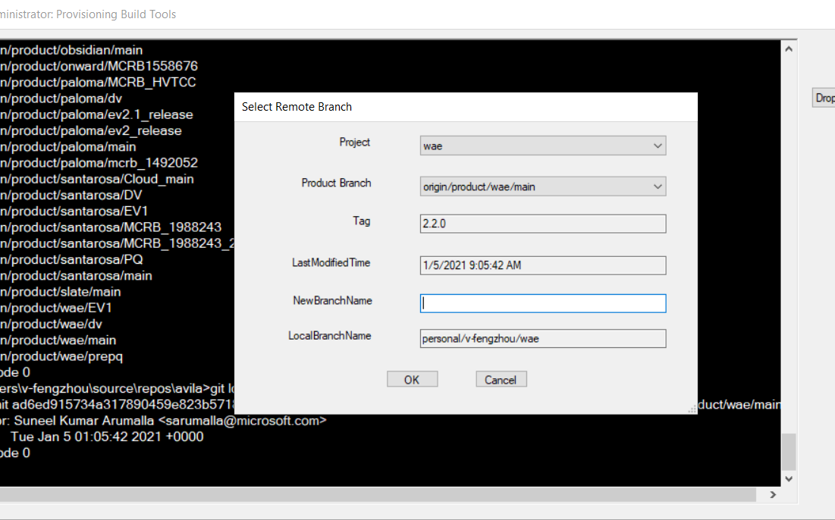
Clone source from remote

Slide 5
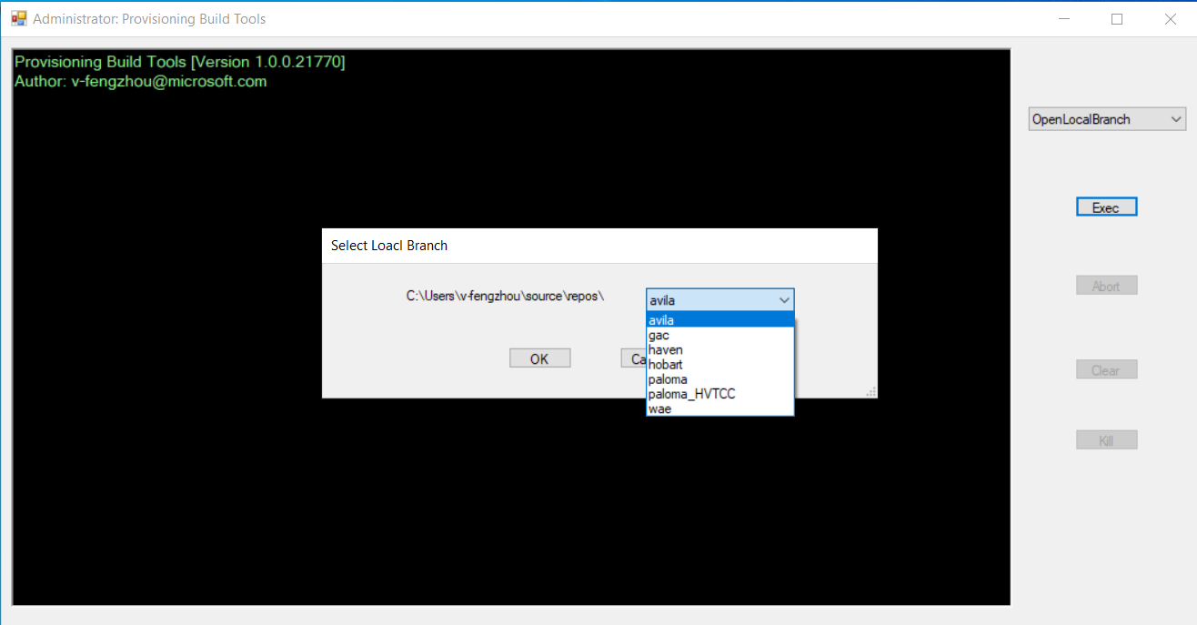
Open local project source in VS2017

Slide 6
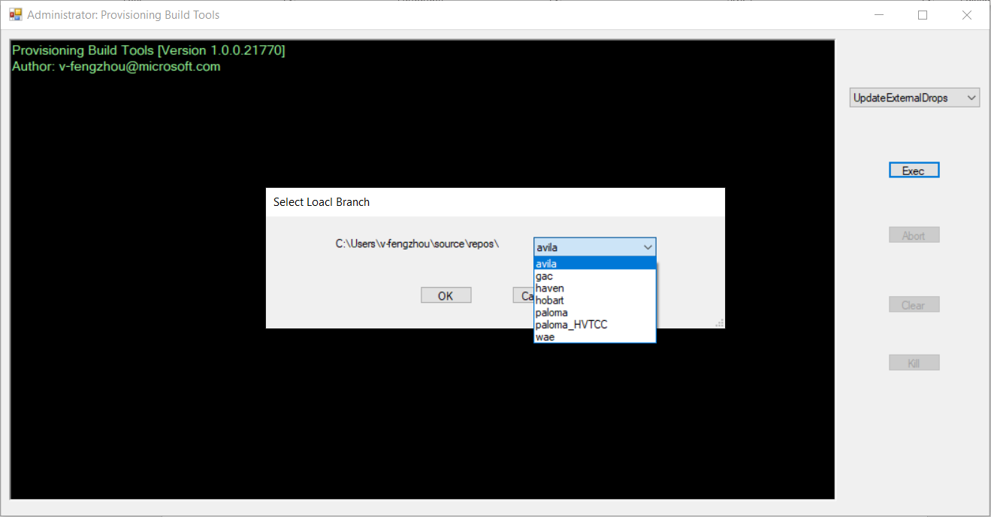
Update External Drops

Slide 7
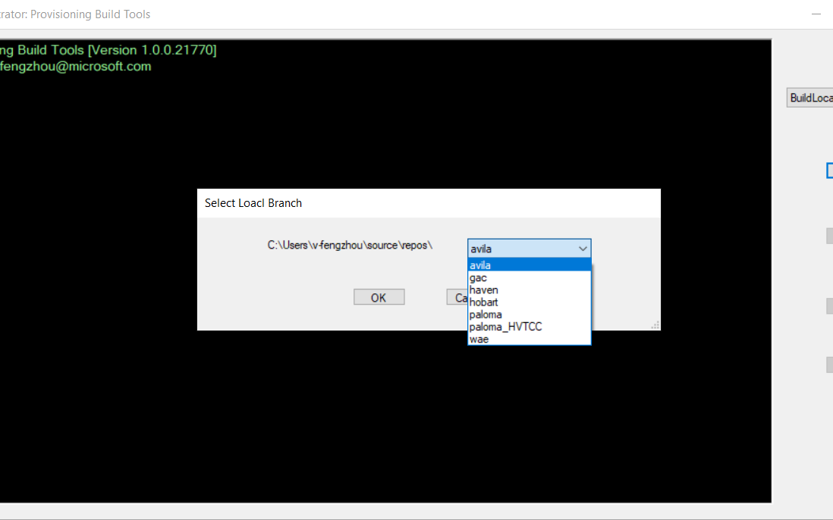
Build local branch and make local package

Slide 8
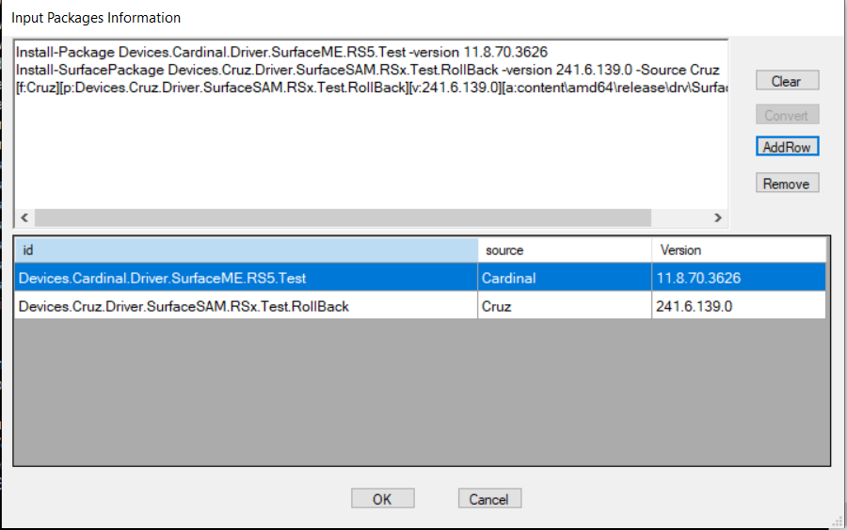
Upload/download local packages from NGET

Slide 9
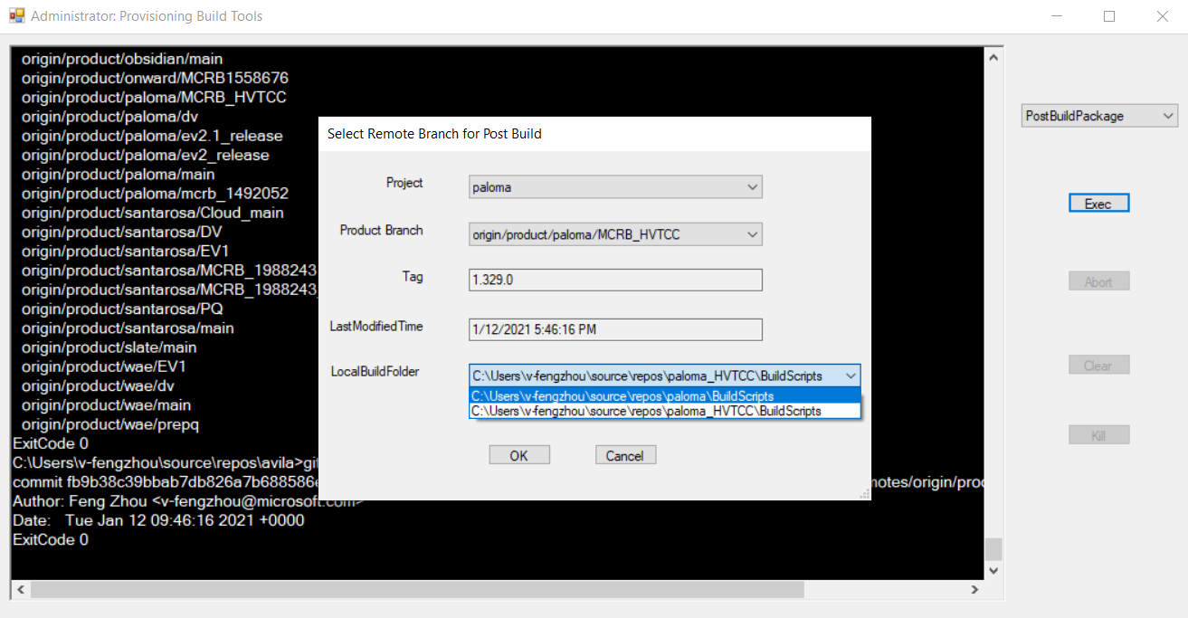
Auto pull server build and generating package

Slide 10
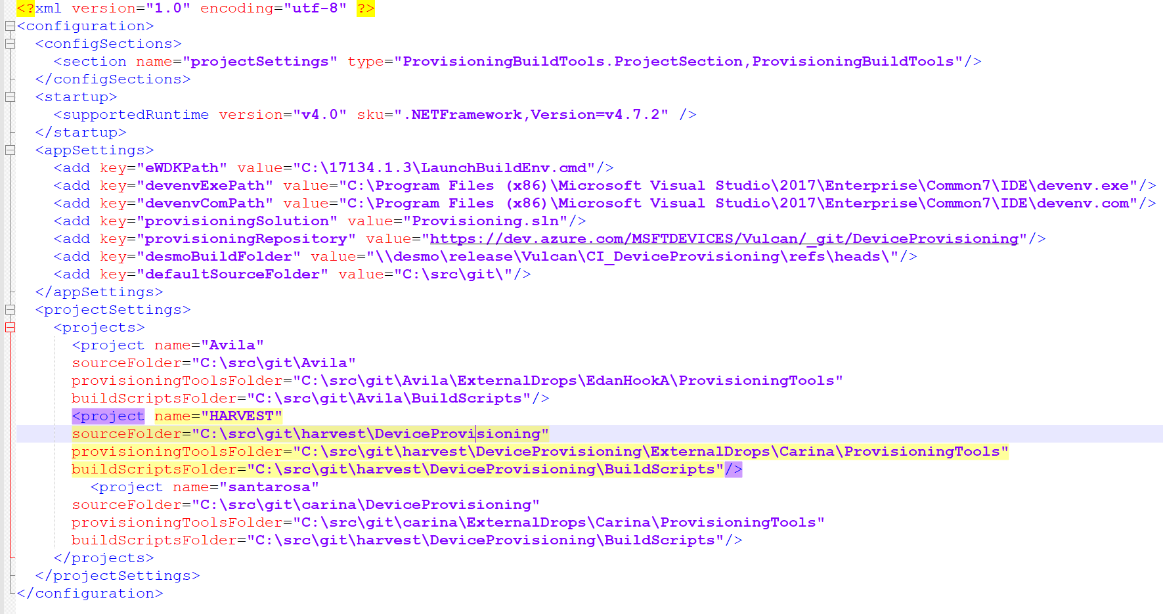
Tool configuration

Slide 11
Q&A
Online Demo

